Slide 1


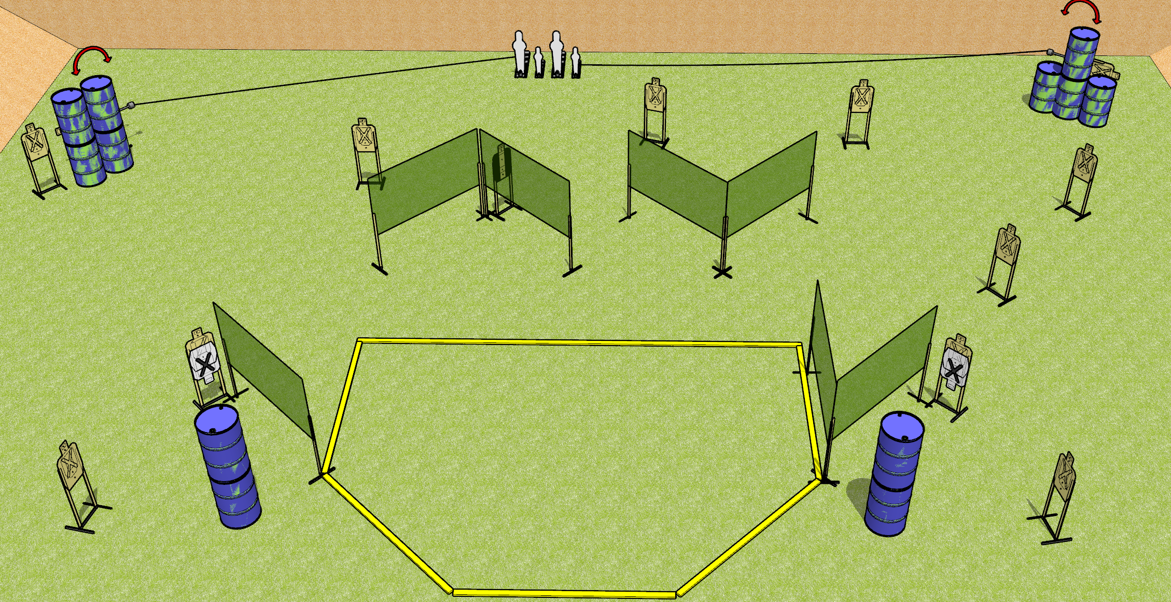
 | Dothan Gun Club – USPSA Match Random Noise Course Designer : Drew Coleman
START POSITION : Standing with both hands (muzzle, for PCC) touching any barrel, completely outside the shooting area.
GUN READY CONDITION : Pistol loaded and holstered. PCC loaded, held with both hands, shouldered, safety on, muzzle touching any barrel. |  | SCORING: Comstock, 30 rounds TARGETS: 13 paper, 4 Steel SCORED HITS: Best 2 on paper, steel until down START-STOP: Audible, last shot RULES:
STAGE PROCEDURE: Engage targets as they become available from within the fault lines.

Slide 2
Random Noise
Written Stage Briefing
Random Noise is a 30 round, 150 point, Comstock field course. There are thirteen USPSA targets, two pepper poppers, and two mini poppers. The best two hits on paper will score, and steel must fall to score.
The leftmost pepper popper activates swinger one on the left, and the rightmost mini popper activates swinger two on the right. Please check the activators prior to walkthrough and make sure they are set the same way for each shooter.
Handgun start position is standing completely outside the shooting area with both hands touching any barrel. Handgun is loaded and holstered.
PCC start position is standing completely outside the shooting area with muzzle touching any barrel. Loaded carbine is held with both hands, shouldered, safety on.
On start signal, engage targets as they become available from within the shooting area.

